Slide 1
Retrieval Augmented Generation (RAG)

Slide 2
What is Retrieval Augmented Generation (RAG)
Retrieval Augmented Generation (RAG) is a technique that enhances LLMs by integrating them with external data sources.
By combining the generative capabilities of models like GPT-4 with precise information retrieval mechanisms, RAG enables AI systems to produce more accurate and contextually relevant responses.

Slide 3
Limitations of LLM
Limited knowledge: LLMs can only generate responses based on their training data, which may be outdated or lack domain-specific information.
Hallucinations: These models sometimes generate plausible-sounding but incorrect information.
Generic responses: Without access to external sources, LLMs may provide vague or imprecise answers.

Slide 4
Why Use RAG to Improve LLMs? Example:
Imagine you are an executive for an electronics company that sells devices like smartphones and laptops. You want to create a customer support chatbot for your company to answer user queries related to product specifications, troubleshooting, warranty information, and more.
You’d like to use the capabilities of LLMs like GPT-3 or GPT-4 to power your chatbot.
However, large language models have the mentioned limitations, leading to an inefficient customer experience

Slide 5
How Does RAG Work?
Step 1: Data collection
Step 2: Data chunking
Step 3: Document embeddings
Step 4: Handling user queries
Step 5: Generating responses with an LLM

Slide 6
Step 1: Data collection
You must first gather all the data that is needed for your application.
In the case of a customer support chatbot for an electronics company, this can include user manuals, a product database, and a list of FAQs.

Slide 7
Step 2: Data chunking
Data chunking is the process of breaking your data down into smaller, more manageable pieces.
For instance, if you have a lengthy 100-page user manual, you might break it down into different sections, each potentially answering different customer questions.
This way, each chunk of data is focused on a specific topic.
When a piece of information is retrieved from the source dataset, it is more likely to be directly applicable to the user’s query, since we avoid including irrelevant information from entire documents.
This also improves efficiency, since the system can quickly obtain the most relevant pieces of information instead of processing entire documents.

Slide 8
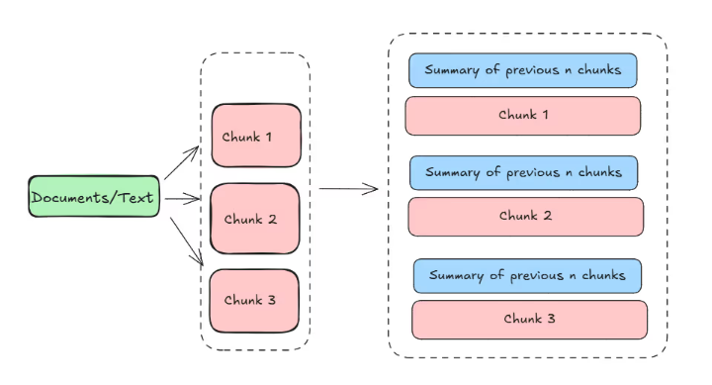

Slide 9
Step 3: Document embeddings
Now that the source data has been broken down into smaller parts, it needs to be converted into a vector representation.
This involves transforming text data into embeddings, which are numeric representations that capture the semantic meaning behind text.
In simple words, document embeddings allow the system to understand user queries and match them with relevant information in the source dataset based on the meaning of the text, instead of a simple word-to-word comparison.
This method ensures that the responses are relevant and aligned with the user’s query.

Slide 10
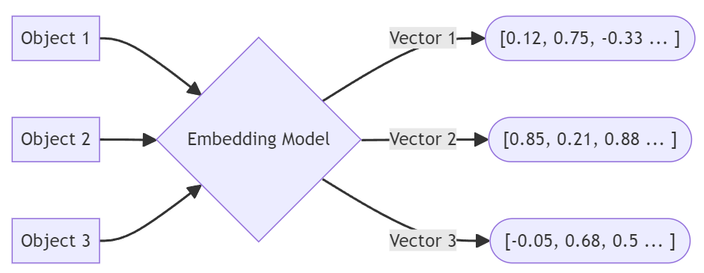

Slide 11
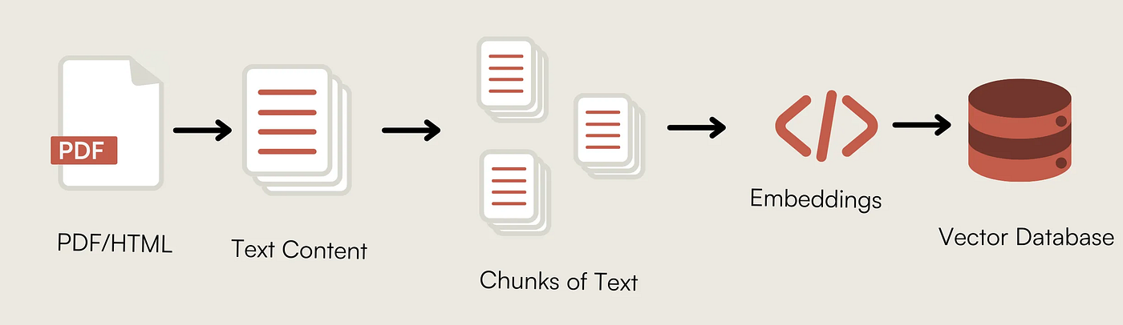

Slide 12
Step 4: Handling user queries
When a user query enters the system, it must also be converted into an embedding or vector representation.
The same model must be used for both the document and query embedding to ensure uniformity between the two.
Once the query is converted into an embedding, the system compares the query embedding with the document embeddings.
It identifies and retrieves chunks whose embeddings are most similar to the query embedding, using measures such as cosine similarity and Euclidean distance.
These chunks are considered to be the most relevant to the user’s query.

Slide 13
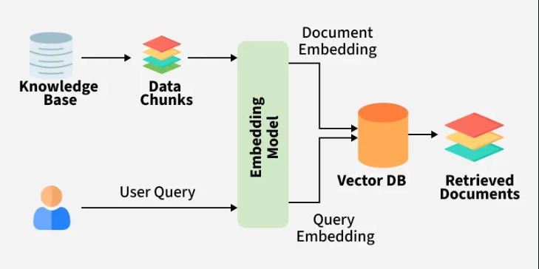

Slide 14
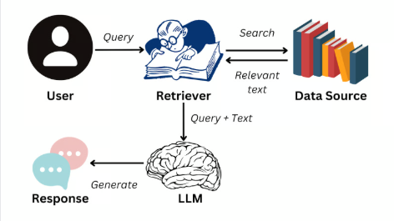
Step 5: Generating responses with an LLM
The retrieved text chunks, along with the initial user query, are fed into a language model. The algorithm will use this information to generate a coherent response to the user’s questions through a chat interface.

